Slide 1
Practical Non-Interactive Searchable Encryption with Forward and Backward Privacy
Shi-Feng Sun/Ron Steinfeld/Shangqi Lai
NDSS 2021
汇报人：魏佩

Slide 2

















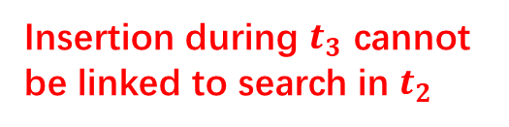

Forward and Backward Privacy
Forward Privacy
Backward Privacy
$$({id}_{1},w_{1})$$
$$({id}_{1},w_{1})$$
$$t_{1}$$
$$t_{1}$$
insert
insert
$$({id}_{2},w_{1})$$
$$w_{1}$$
$$t_{2}$$
用户
$$t_{2}$$
search
Cloud Server
search
用户
Cloud Server
$$({id}_{1},w_{1})$$
$$({id}_{2},w_{1})$$
$$t_{3}$$
$$t_{3}$$
delete
insert
$$w_{1}$$
$$t_{4}$$
search
Insertion during $t_{3}$ cannot
be linked to search in $t_{2}$
deletion during $t_{3}$ cannot be linked to search in $t_{4}$

Slide 3
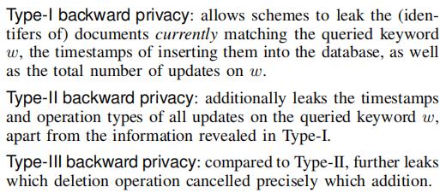




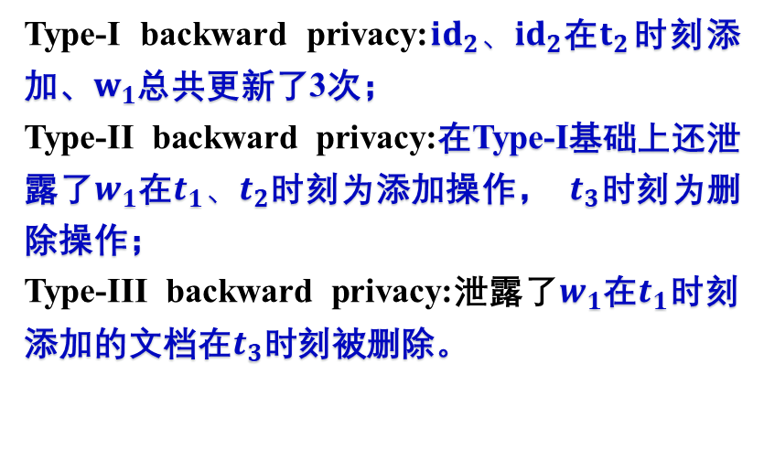




Three flavors of backward Privacy for single-keyword search
Three flavors of backward Privacy
$$({id}_{1},{\{w}_{1}{,w}_{2}\})$$
$$t_{1}$$
add
$$({id}_{2},w_{1})$$
$$t_{2}$$
add
Type-I backward privacy:${id}_{2}、{id}_{2}$在$t_{2}$时刻添加、$w_{1}$总共更新了3次；
Type-II backward privacy:在Type-I基础上还泄露了$w_{1}$在$t_{1}、t_{2}$时刻为添加操作， $t_{3}$时刻为删除操作；
Type-III backward privacy:泄露了$w_{1}$在$t_{1}$时刻添加的文档在$t_{3}$时刻被删除。
用户
Cloud Server
$$({id}_{1},w_{1})$$
$$t_{3}$$
del
$$({id}_{3},w_{2})$$
$$t_{4}$$
add

Slide 4











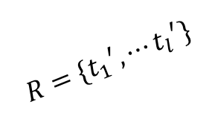

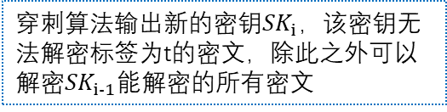
Puncturable Encryption (PE)
M
Puncturable Encryption (PE)
Encrypt(-$,$-)
msk
$${ct}_{T}$$
tags
$T=\{t_{1},$ $t_{2},⋯t_{l}\}$
Decrypt(-$,$-)
KeyGen($1^{λ}$)
M$/⊥$
$${sk}_{i−1}$$
输出公钥PK和初始密钥SK
$${sk}_{i}$$
msk
$$R=\{{t_{1}}^{′},⋯{t_{l}}^{′}\}$$
Puncture(-$,$-)
Incremental puncture
$${t_{i}}^{′}$$
穿刺算法输出新的密钥${SK}_{i}$，该密钥无法解密标签为t的密文，除此之外可以解密${SK}_{i−1}$能解密的所有密文
$${SK}_{i}$$
$${SK}_{i−1}$$
$$({{msk}_{i}}^{′},{psk}_{1},⋯,{psk}_{i−1},{{psk}_{i}}^{′})←Punc({msk}_{i−1},{psk}_{1},⋯{psk}_{i−1},{t_{i}}^{′})$$
$$({{msk}_{i}}^{′},{{psk}_{i}}^{′})←IncPunc({msk}_{i−1},{t_{i}}^{′})$$

Slide 5


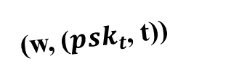

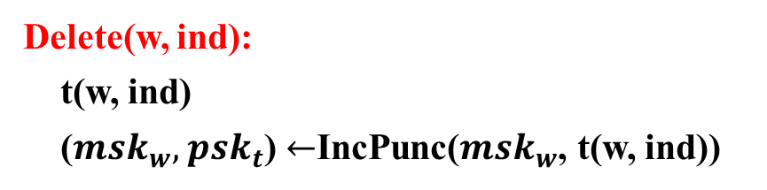

之前方案：
Insert(w, ind):
t(w, ind)
ct $←$Enc(t(w, ind), ind)
Delete(w, ind):
t(w, ind)
(${msk}_{w},$ ${psk}_{t}$) $←$IncPunc(${msk}_{w}$, t(w, ind))
$$∑_{add}$$
(w, (ct, t))
Client
(w, (${psk}_{t}$, t))
$$∑_{del}$$
Server

Slide 6
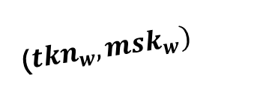
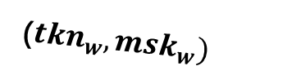




之前方案：
Search(w)
(${tkn}_{w},{msk}_{w})$
(ct, t)
$$∑_{add}$$
Leakage: leaks which deletion removes which insertion
$${msk}_{w}$$
ind’s
Dec
{(${psk}_{t},t^{′}$)}
Client
(${tkn}_{w},{msk}_{w})$
$$∑_{del}$$
Server

Slide 7

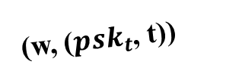

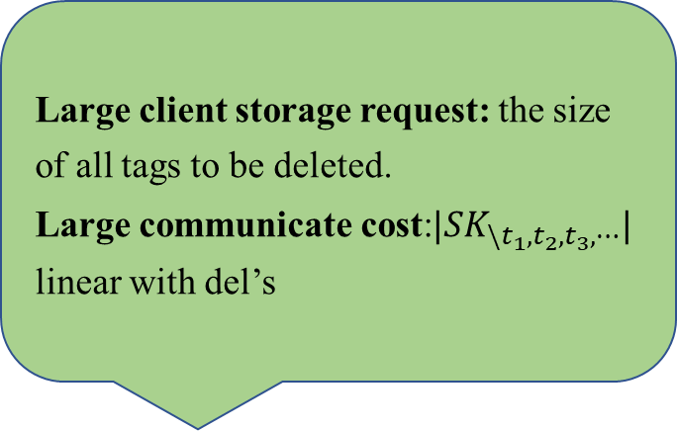

改进：
Hide the deletions
Large client storage request: the size of all tags to be deleted.
Large communicate cost:$|{SK}_{\backslash t_{1},t_{2},t_{3},⋯}|$ linear with del’s
$$∑_{add}$$
(w, (ct, t))
Client
(w, (${psk}_{t}$, t))
w | $$t_{1}$$ | $$t_{2}$$ | $$t_{3}$$ | $$t_{4}$$ | $$t_{5}$$ | $$⋯$$
$$∑_{del}$$
Server

Slide 8
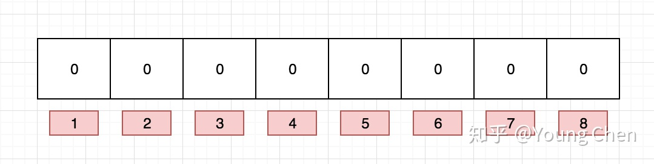
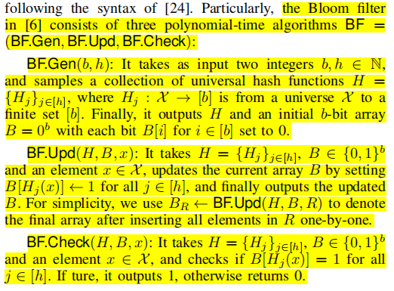
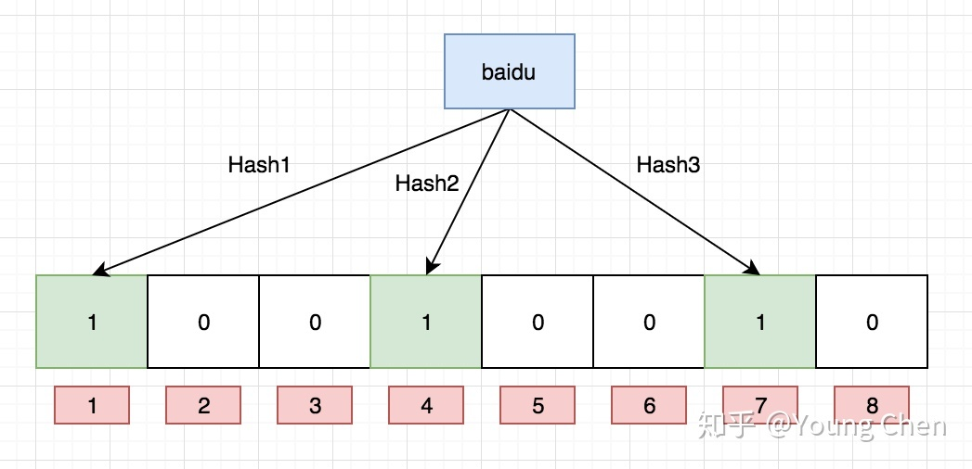
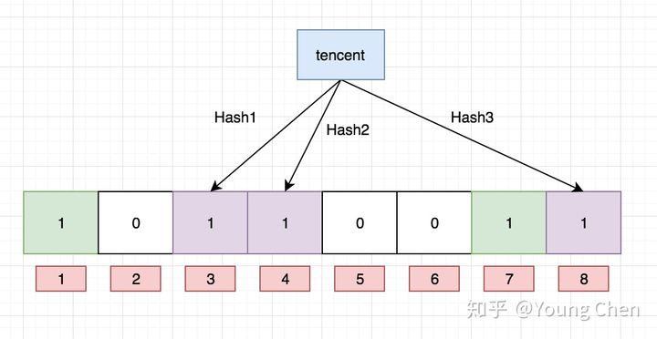
Bloom Filter
Bloom Filter
查询：
（1）查询“dianping”这个值是否存在---1,5,8；
（2）查询“baidu”这个值是否存在---1,4,7；
（3）查询“taobao”这个值是否存在；

Slide 9
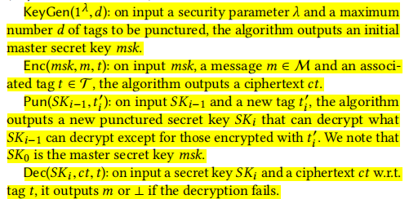

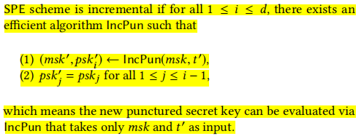
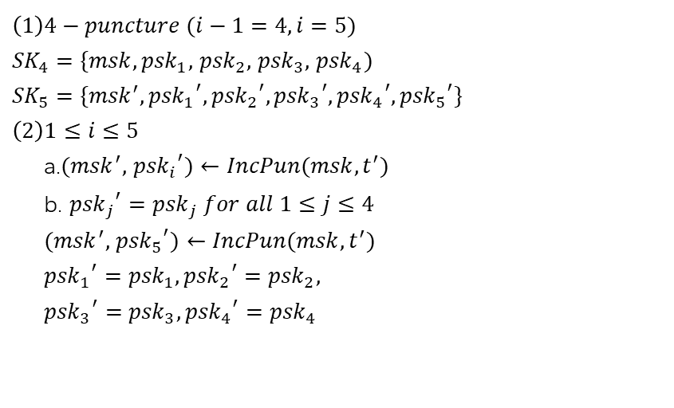
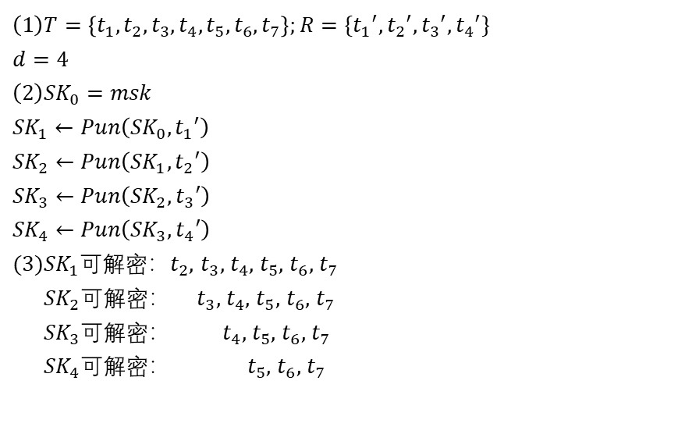
SPE/Incremental Puncture
SPE
Incremental Puncture
$$\left(1\right)T=\left\{t_{1},t_{2},t_{3},t_{4},t_{5},t_{6},t_{7}\right\};R=\{{t_{1}}^{′},{t_{2}}^{′},{t_{3}}^{′},{t_{4}}^{′}\}$$
$$d=4$$
$$\left(2\right){SK}_{0}=msk$$
$${SK}_{1}←Pun\left({SK}_{0},{t_{1}}^{′}\right)$$
$${SK}_{2}←Pun\left({SK}_{1},{t_{2}}^{′}\right)$$
$${SK}_{3}←Pun\left({SK}_{2},{t_{3}}^{′}\right)$$
$${SK}_{4}←Pun\left({SK}_{3},{t_{4}}^{′}\right)$$
$(3){SK}_{1}$可解密：$t_{2},$ $t_{3},$ $t_{4},$ $t_{5},$ $t_{6},$ $t_{7}$
${SK}_{2}$可解密： $t_{3},$ $t_{4},$ $t_{5},$ $t_{6},$ $t_{7}$
${SK}_{3}$可解密： $t_{4},$ $t_{5},$ $t_{6},$ $t_{7}$
${SK}_{4}$可解密： $t_{5},$ $t_{6},$ $t_{7}$
$$\left(1\right)4−puncture (i−1=4,i=5)$$
${SK}_{4}=\{msk,{psk}_{1},$ ${psk}_{2},$ ${psk}_{3},$ ${psk}_{4})$
$${SK}_{5}=\{{msk}^{′},{{psk}_{1}}^{′},{{psk}_{2}}^{′},{{psk}_{3}}^{′},{{psk}_{4}}^{′},{{psk}_{5}}^{′}\}$$
$$\left(2\right)1≤i≤5$$
a.$({msk}^{′},$ ${{psk}_{i}}^{′})←IncPun(msk,t^{′})$
b. ${{psk}_{j}}^{′}={psk}_{j} for all 1≤j≤4$
$({msk}^{′},$ ${{psk}_{5}}^{′})$ $←IncPun(msk,t^{′})$
${{psk}_{1}}^{′}={psk}_{1},{{psk}_{2}}^{′}={psk}_{2},$
${{psk}_{3}}^{′}={psk}_{3},{{psk}_{4}}^{′}={psk}_{4}$

Slide 10

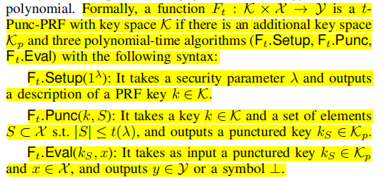
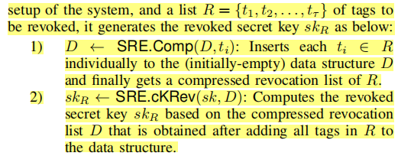






CSRE
CSRE (compressed SRE) : an encryption scheme that can revoke a list of tags {$t_{i}$} in one shot with a low storage request!
S={$x_{1},$ $⋯$, $x_{l}$}
x
F(k, x)
$$x∉S$$
k
$$F_{t}.Eval$$
$$F_{t}.Punc$$
$$k_{S}$$
$$⊥$$
others

Slide 11
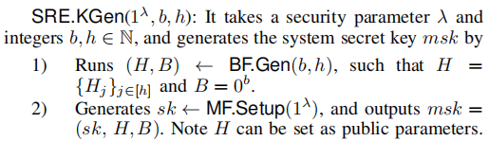
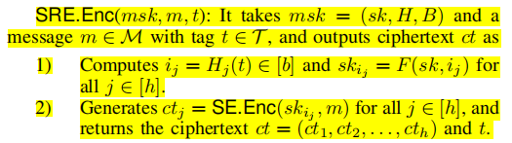



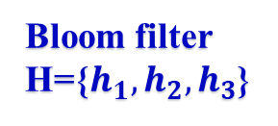

CSRE
Cons. CSRE
Bloom filter
H={$h_{1},h_{2},h_{3}$}
t
b=16
$$h_{1}(t)$$
$$h_{2}(t)$$
$$h_{3}(t)$$
B
0 | 0 | 0 | 0 | 0 | 0 | 0 | 0 | 0 | 0 | 0 | 0 | 0 | 0 | 0 | 0
B
0 | 0 | 0 | 0 | 0 | 0 | 0 | 0 | 0 | 0 | 0 | 0 | 0 | 0 | 0 | 0
1
2
3
4
5
6
7
8
9
10
11
13
14
16
1
3
12
15
2
4
5
6
7
8
9
10
11
13
14
16
12
15
F(sk, 1)
F(sk, 7)
F(sk, 15)
ct=(${ct}_{1},$ ${ct}_{2},$ ${ct}_{3}$)
vv
SE.Enc
vvv
m
SE.Enc
vvv
SE.Enc

Slide 12
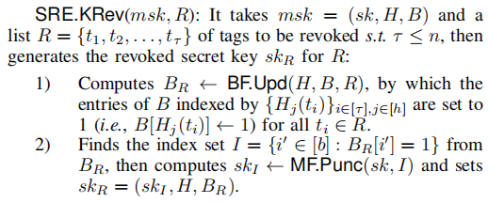
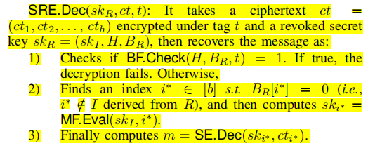









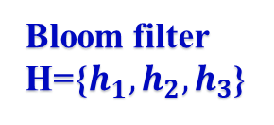



CSRE
$$t_{1}$$
$$t_{2}$$
$$t_{3}$$
t
$$h_{1}(t)$$
$$h_{3}(t)$$
$$h_{1}(t_{3})$$
$$h_{3}(t_{3})$$
$$h_{2}(t)$$
$$h_{2}(t_{3})$$
$$B_{R}$$
1 | 0 | 1 | 1 | 0 | 1 | 0 | 0 | 1 | 0 | 1 | 0 | 1 | 0 | 1 | 0
$$B_{R}$$
1 | 0 | 1 | 1 | 0 | 1 | 0 | 0 | 1 | 0 | 1 | 0 | 1 | 0 | 1 | 0
1
2
3
4
5
6
7
8
9
10
11
13
14
16
1
2
3
4
5
6
7
8
9
10
13
12
15
11
14
16
12
15
sk
Bloom filter
H={$h_{1},h_{2},h_{3}$}
$${sk}_{I}$$
MF.Punc
MF.Eval
$${sk}_{I}$$
F(sk, 7)

Slide 13
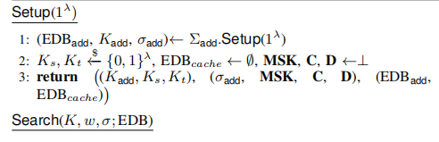
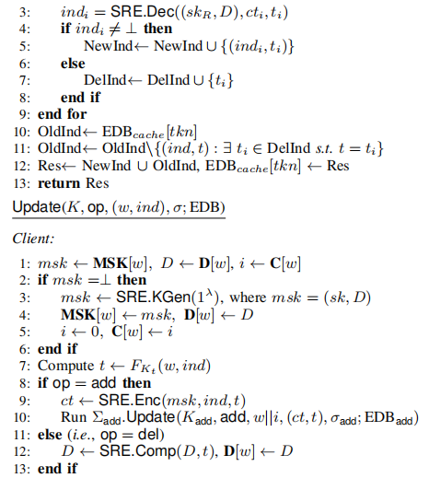
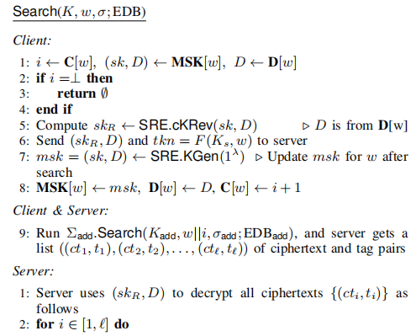



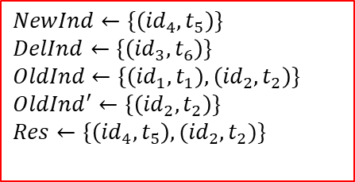







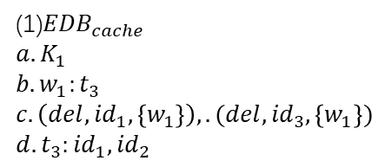







Matters Needing Attention
$${id}_{1}$$
$${id}_{2}$$
search
$${id}_{4}$$
$${id}_{3}$$
$${id}_{1}$$
search
$${id}_{3}$$
$$×$$
$$×$$
$$t_{1}$$
$$t_{2}$$
$$t_{3}$$
$$t_{4}$$
$$t_{5}$$
$$t_{6}$$
$$t_{7}$$
$$t_{8}$$
(1)${EDB}_{cache}$
$$a.K_{1}$$
$$b.w_{1}:t_{3}$$
$$c.\left(del,{id}_{1},\left\{w_{1}\right\}\right),.(del,{id}_{3},\left\{w_{1}\right\})$$
$$d.t_{3}:{id}_{1},{id}_{2}$$
$$NewInd←\{\left({id}_{4},t_{5}\right)\}$$
$$DelInd←\{\left({id}_{3},t_{6}\right)\}$$
$$OldInd←\{\left({id}_{1},t_{1}\right),\left({id}_{2},t_{2}\right)\}$$
$${OldInd}^{′}←\{\left({id}_{2},t_{2}\right)\}$$
$$Res←\{\left({id}_{4},t_{5}\right),{(id}_{2},t_{2})\}$$
$$(\left({id}_{3},t_{4}\right),\left({id}_{4},t_{5}\right))$$

Slide 14
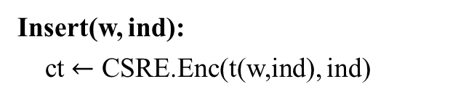


Aura based on CSRE
Aura based on CSRE
Insert(w, ind):
ct $←$ CSRE.Enc(t(w,ind), ind)
$$∑_{add}$$
(w, (ct, t))
Client
$$∑_{del}$$
Server

Slide 15

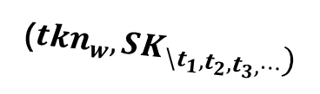
Aura based on CSRE
Aura based on CSRE
(${tkn}_{w},{SK}_{\backslash t_{1},t_{2},t_{3},⋯})$
(ct, t)
$$∑_{add}$$
$${SK}_{\backslash t_{1},t_{2},t_{3},⋯}$$
ind’s
SRE.Dec
Client
w | $$t_{1}$$ | $$t_{2}$$ | $$t_{3}$$ | $$t_{4}$$ | $$t_{5}$$ | $$⋯$$
$$∑_{del}$$
compact
Server

Slide 16


































Instantiation
$$sk$$
$$G(sk)$$
Deleted ind
Revoked sk
$$G_{0}(sk)$$
$${sk}_{0}$$
$${sk}_{1}$$
$$G_{1}(sk)$$
$$G_{0}({sk}_{0})$$
$${sk}_{00}$$
$${sk}_{01}$$
$$G_{1}({sk}_{0})$$
$${sk}_{10}$$
$$G_{1}({sk}_{1})$$
$${sk}_{11}$$
$$G_{1}({sk}_{1})$$
$${sk}_{000}$$
$${sk}_{001}$$
$${sk}_{010}$$
$${sk}_{011}$$
$${sk}_{100}$$
$${sk}_{101}$$
$${sk}_{110}$$
$${sk}_{111}$$
$$G_{0}({sk}_{000})$$
$$G_{1}({sk}_{001})$$
$$G_{0}({sk}_{010})$$
$$G_{1}({sk}_{011})$$
$$G_{0}({sk}_{100})$$
$$G_{1}({sk}_{101})$$
$$G_{0}({sk}_{110})$$
$$G_{1}({sk}_{111})$$
0
1
2
3
4
5
6
7
$${id}_{1}$$
$$t$$
$${id}_{2}$$
$$t$$

Slide 17
THANKS!

